Slide 1

Arduino/C++ Workshop
ECU Robotics Society – Keegan Barnard, Jessica Dippenaar

Slide 2
Today’s Session - Wednesday
9am-12pm, Explanation of the joystick to direction conversion, understanding HEX, Binary and the 74HC595 shift register to create a binary counter
12pm-1pm, Lunch
1pm-3pm, Shifting right, shifting left and Creating a binary hexadecimal bit flipper

Slide 3
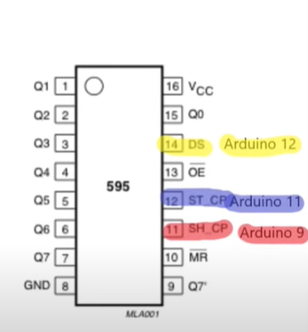
74HC595
16 pin input/output

Slide 4
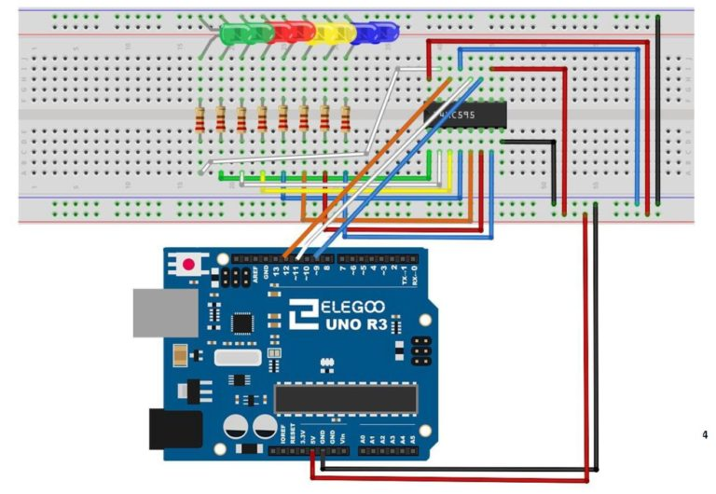
Using the shift register
NOTE THE LOCATION OF THE CIRCLE (THE REGISTER WILL HEAT UP IF IT IS IN THE WRONG DIRECTION)

Slide 5
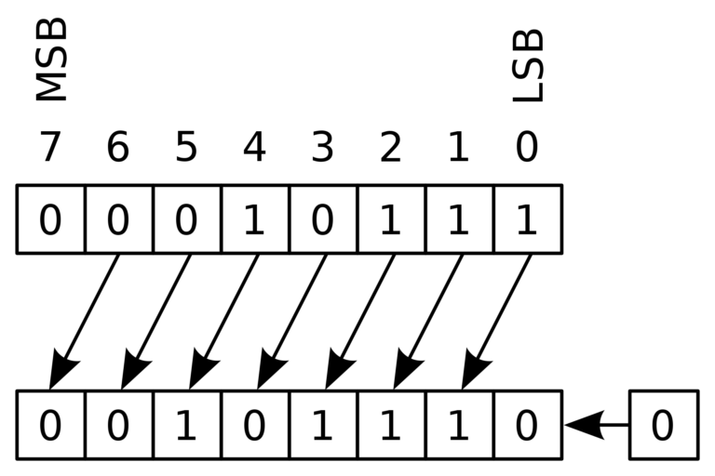
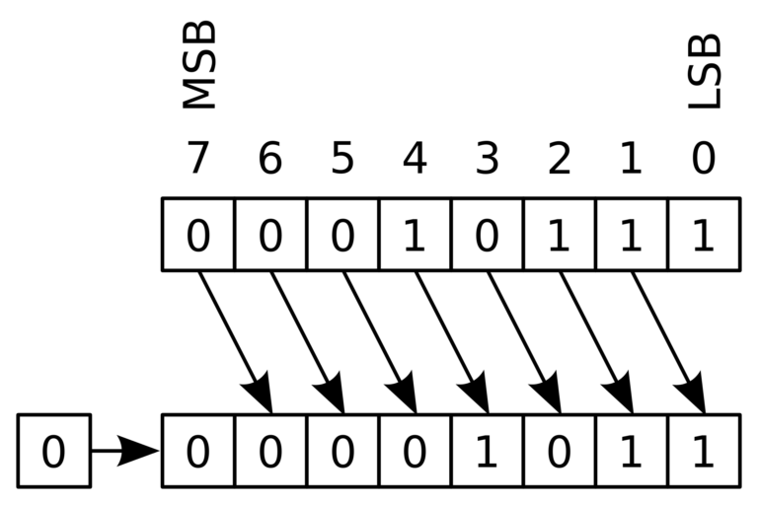
LSL + LSR

Slide 6
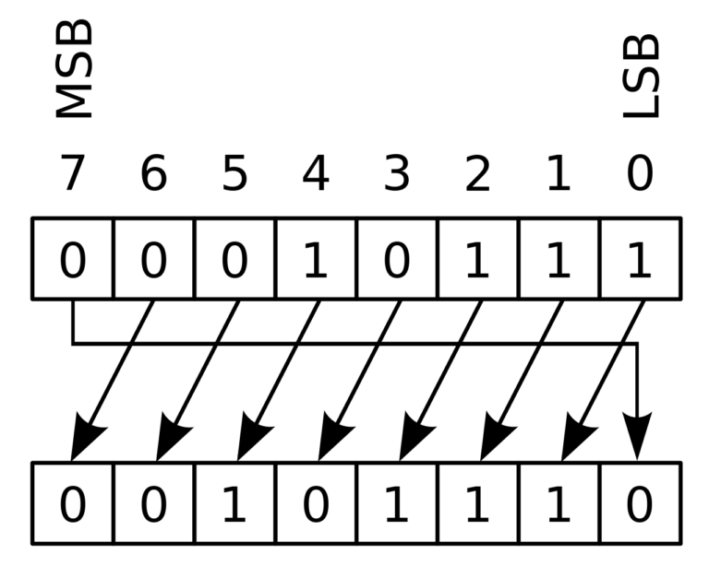
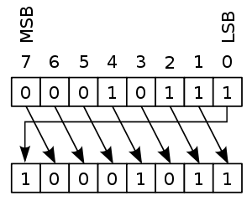
LSL + LSR

